Slide 1
Professor Peter Debney
Formed in 1976 to develop software for Arup
Due to success – the software was commercialised with Oasys Ltd incorporated in 1979
Lead developers are engineers who have moved to programming
Making Good Structural Analysis Models
This presentation is protected by international copyright laws. Reproduction and distribution of the presentation without written permission from Peter Debney or Oasys Ltd is prohibited. Enquiries: oasys@arup.com

Slide 2


Introduction
The webinar has now started – please check your audio
Making Good Structural Analysis Models
Nigel Rees
Commercial Manager
Peter Debney
Application Specialist
Visiting Professor Bradford University

Slide 3
Principles of Good Modelling

Slide 4
As Accurate as is necessary
“It’s better to be roughly right than precisely wrong.”
John Maynard Keynes

Slide 5
As Accurate as is necessary
“Everything is vague to a degree you do not realise until you have tried to make it precise…”
Bertrand Russell

Slide 6
Accuracy - Verification
“the process of determining that a calculation method implementation accurately represents the developer’s conceptual description of the calculation method and the solution of the calculation method.” (ISO 16730)
In other words: is the model correct?

Slide 7
Accuracy - Verification
Are all the loads, dimensions, sections, and materials correct

Slide 8
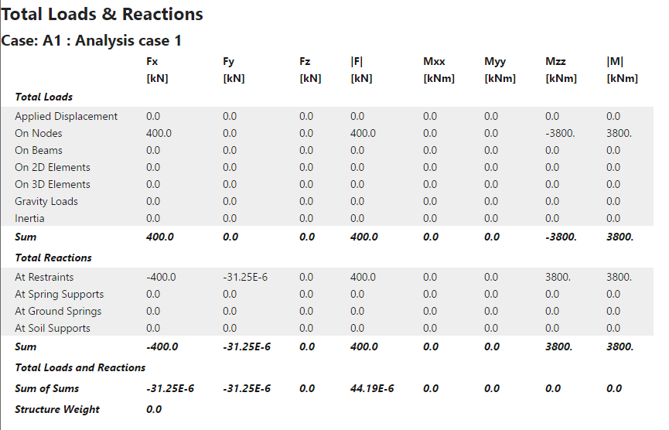
Accuracy - Verification
Are all the loads, dimensions, sections, and materials correct?
Sum total loads and reactions

Slide 9
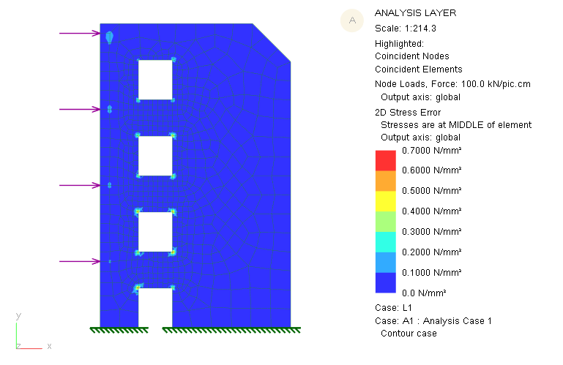
Accuracy - Verification
Are all the loads, dimensions, sections, and materials correct?
Sum total loads and reactions
Check mesh shapes are not too stretched

Slide 10
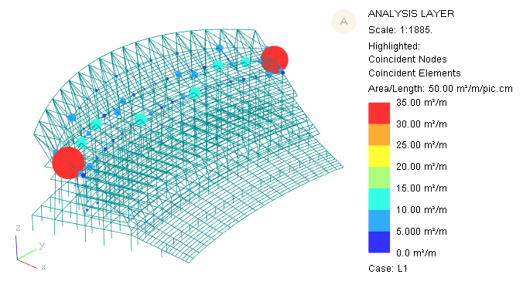
Accuracy - Verification
Are all the loads, dimensions, sections, and materials correct?
Sum total loads and reactions
Check mesh shapes are not too stretched
Check for very short or long elements

Slide 11
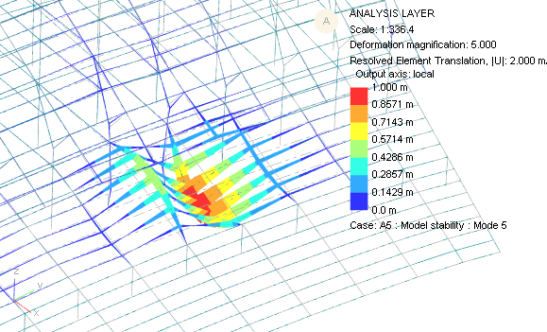
Accuracy - Verification
Are all the loads, dimensions, sections, and materials correct?
Sum total loads and reactions
Check mesh shapes are not too stretched
Check for very short or long elements
Stability Analysis

Slide 12
As Realistic as is appropriate
“It is the mark of an educated man to look for precision in each class of things just so far as the nature of the subject admits.”
Aristotle

Slide 13
As Realistic as is appropriate
“Models are simplified reproductions of portions of reality that, if validated, are still able to capture a few of its essential properties.”
Guido Fioretti

Slide 14
Model Validation
“the process of determining the degree to which a calculation method is an accurate representation of the real world from the perspective of the intended uses of the calculation method.” (ISO 16730)
In other words: is the model realistic?

Slide 15
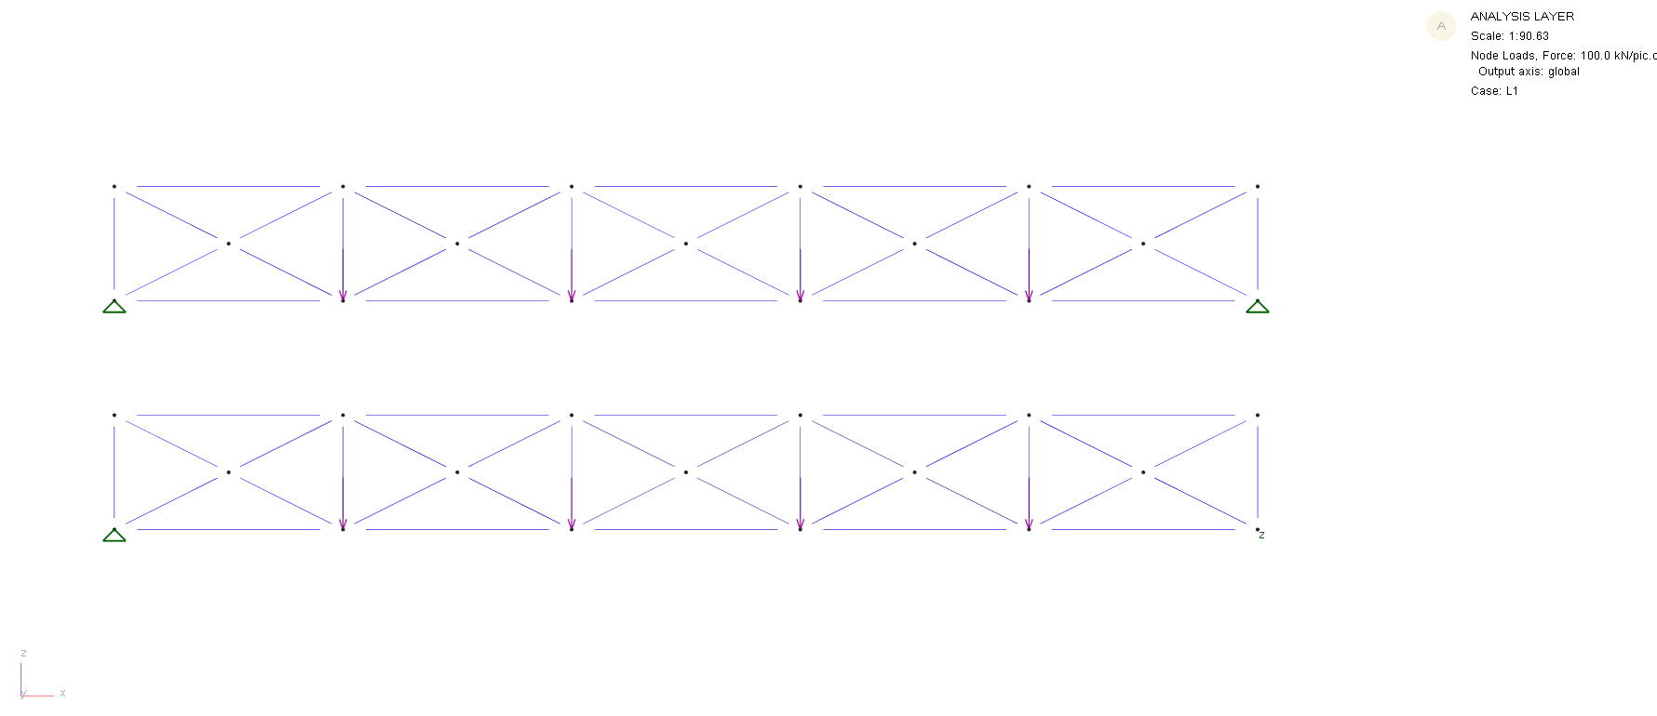
Realistic Boundary Conditions

Slide 16
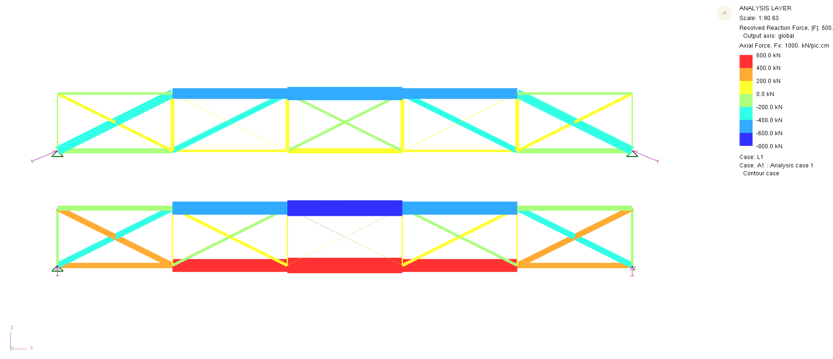
Realistic Boundary Conditions

Slide 17
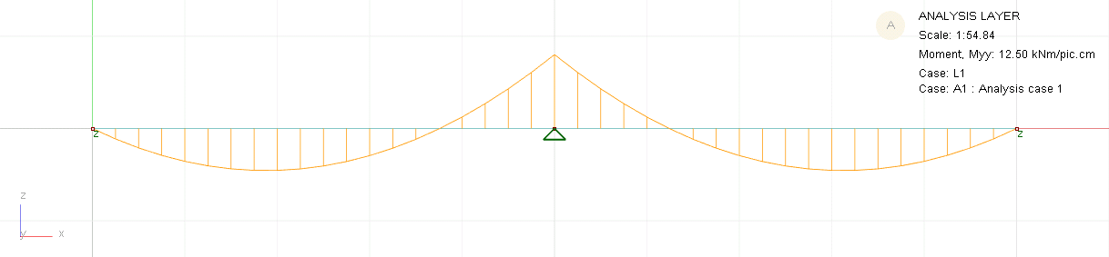
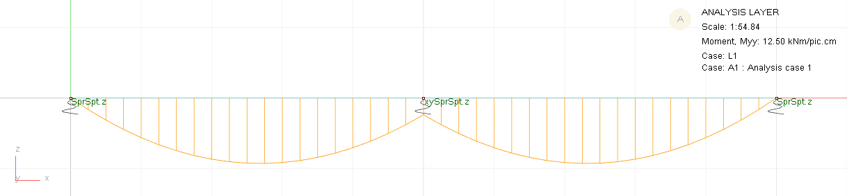
Realistic Restraint Stiffness

Slide 18
As Simple as possible
"Perfection is achieved not when there is nothing more to add,
But when there is nothing left to take away"
Antoine de Saint-Exupery

Slide 19
As Simple as possible
"Make things as simple as possible, but no simpler."
Albert Einstein
Have you included what you need to include?
Have you removed what you can remove?

Slide 20
Captures the Important behaviours
“All models are approximations. Essentially, all models are wrong, but some are useful. However, the approximate nature of the model must always be born in mind.”
George E.P Box and Norman Draper

Slide 21
Sleipner A Oilrig Collapse

Slide 22
Checklist for Checking
Stage 1 – look and think
  Is the displaced shape correct?
  Does the bending moments or stress distribution look sensible?
  Are there any discontinuities in the results?
Stage 2 – see if the answers are sensible
  Do a separate hand calculation
  Build a simplified FEA model of the structure
Stage 3 – check really carefully
  Build the model again in another program, or get someone else to do it

Slide 23
Structural Types
Model Types

Slide 24
Model Types
1D – single beam, column, or slab
2D – portal frame, truss, or floor
3D – whole building or bridge

Slide 25
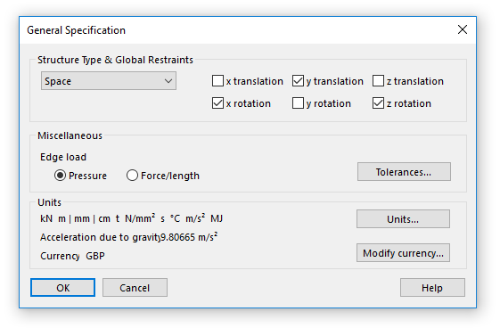
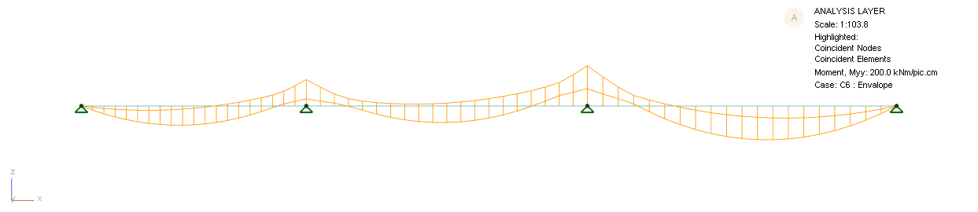
1D Models
Beams
Columns
…

Slide 26
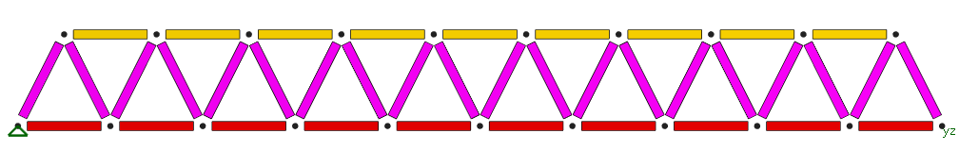
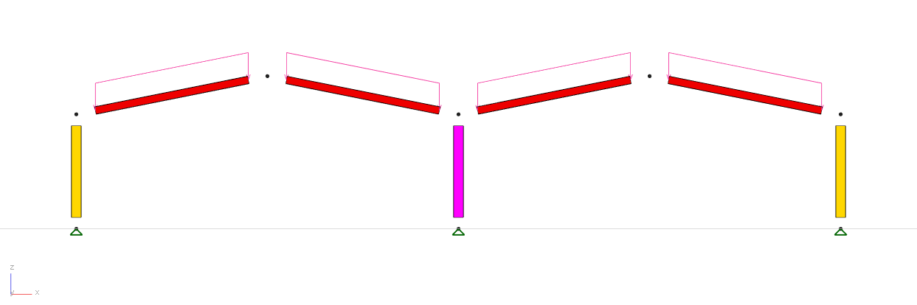
2D Models
Plane frame

Slide 27
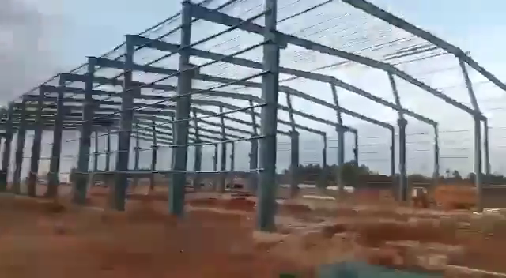
2D models restrain out of plane, but does the design?
Notes:
Watch out for out-of-plane effects, whether stability or dynamic

Slide 28
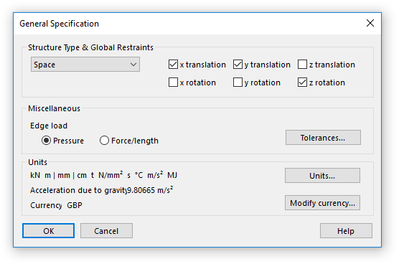
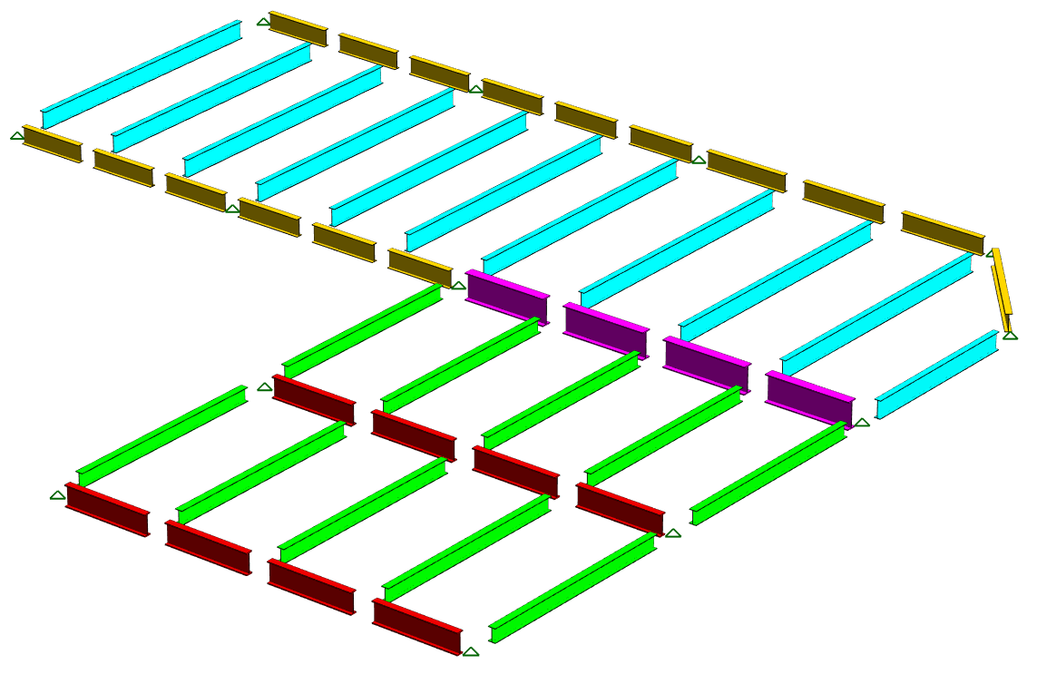
2D Models
Plane frame
Floor

Slide 29
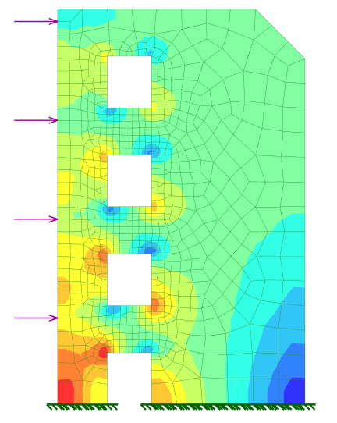
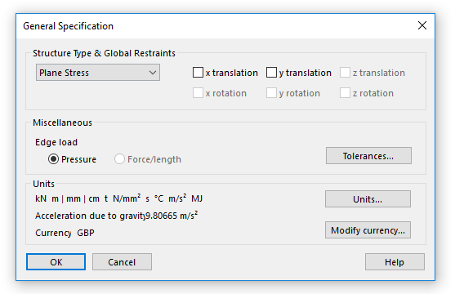
2D Models
Plane frame
Floor
Plane Stress

Slide 30
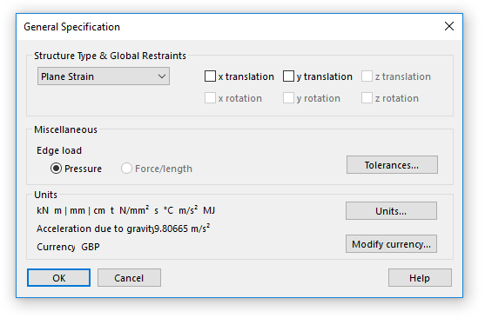
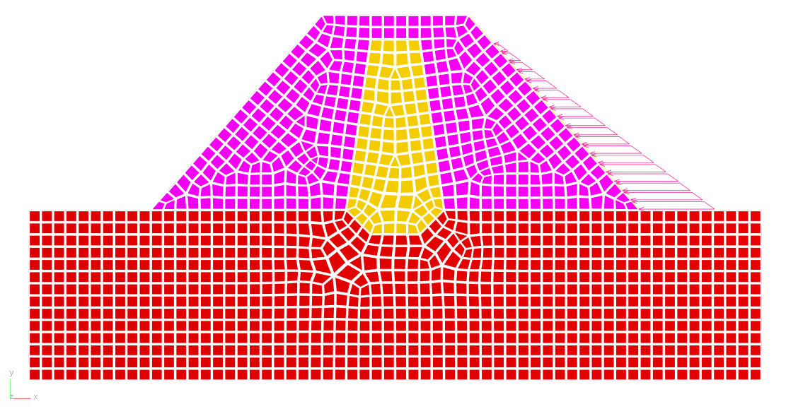
2D Models
Plane frame
Floor
Plane Stress
Plane Strain

Slide 31
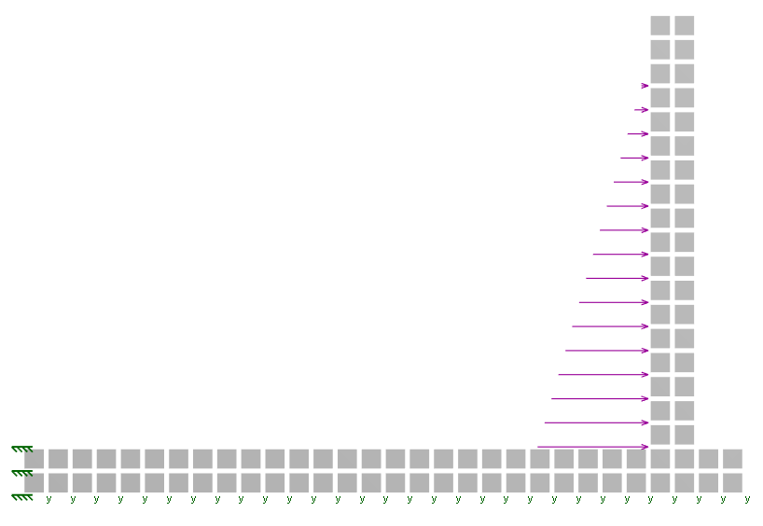
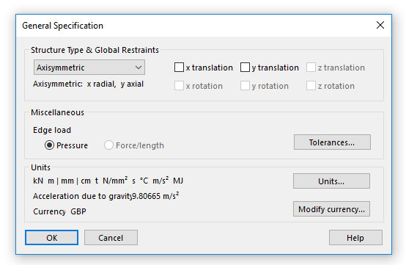
2D Models
Plane frame
Floor
Plane Stress
Plane Strain
Axisymmetric

Slide 32
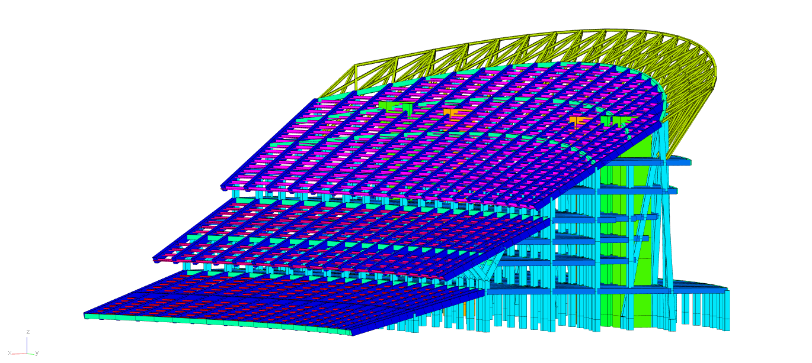
3D Models

Slide 33
Structural Types
Stick
Shell
Mass
1D elements
2D elements
3D elements

Slide 34
Element Types

Slide 35
3D Elements
BRICK8
/ HEX8
3D Element Formulations
Solid
Infinite
PENT6
TET4
Notes:
Tetrahedron
Hexahedron / Brick
Pentahedron / Prismatic

Slide 36
2D Elements
TRI
2D Element Formulations
Plane Stress
Plane Strain
Axisymmetric
Plate
Shell
Curved Shell
Fabric
Load Panel
Wall
TRI3
TRI6
QUAD
QUAD4
QUAD8
Linear
Parabolic

Slide 37
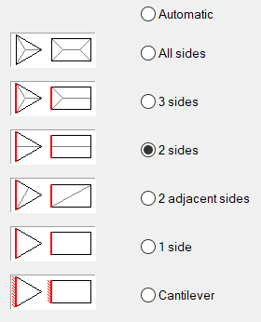
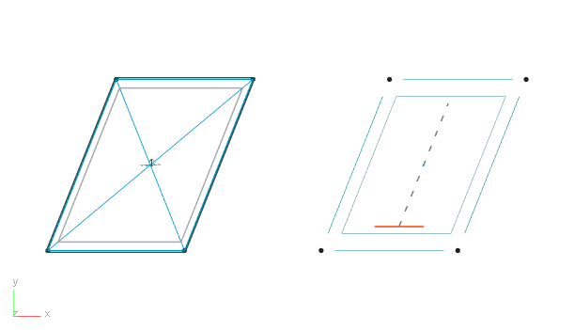
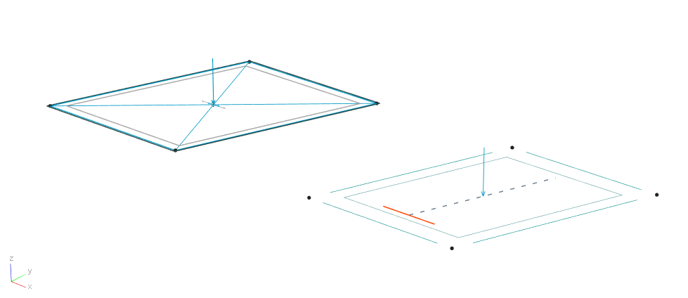
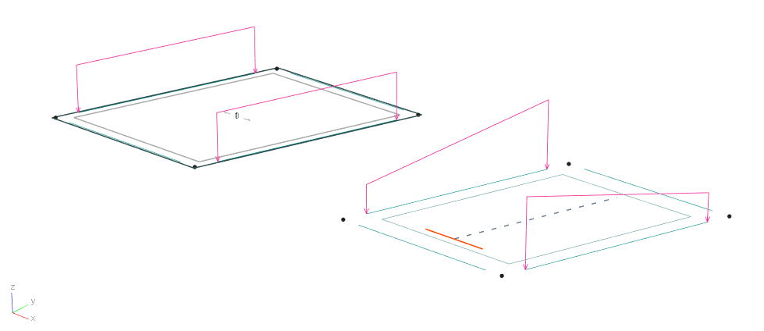
2D Elements – Grid Loads vs. Load Panels

Slide 38
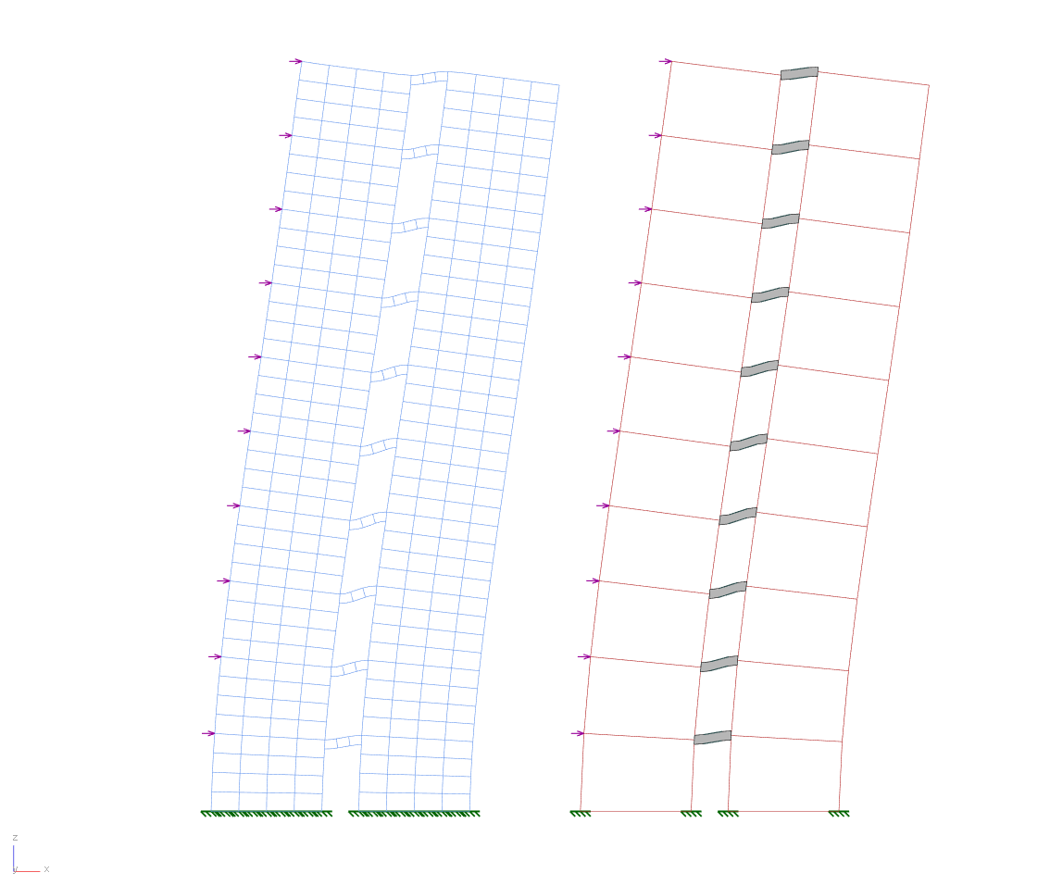
2D Elements – Wall Elements

Slide 39
1D Elements
1D Element Formulations
Beam
Bar (Truss)
Rod
Strut
Tie
Cable
Spring
Link

Slide 40
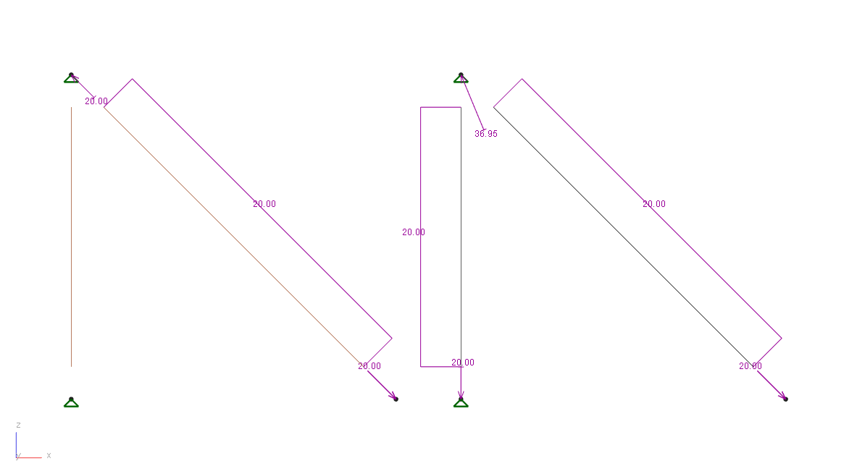
1D Elements – Ties vs. Sliding Cables

Slide 41
0D Elements
0D Element Formulations
Mass
Ground Spring
Notes:
Mass elements – dynamic models (or use Loads converted to mass)
Ground Springs – nonlinear boundary conditions

Slide 42
Conclusion

Slide 43
What makes a good model?
Good models:
Are as accurate as necessary
Are as realistic as appropriate
Are as simple as possible
Capture the important behaviours

Slide 44
Peter.Debney@arup.com
www.linkedin.com/in/peterdebney
Notes:
Now does anyone have any questions? Just write them in the question box in your control panel

